Slide 1

COMP 469
AI Agents
and Foundations
Week 1: define intelligence, build agent vocabulary, and prepare for the grid-world lab.
COMP 469 | CSU Channel Islands
01
Notes:
Use this as the opening frame. Emphasize that this course studies AI as agent design: a system perceives, reasons, acts, and improves. Tell students that Chapters 1 and 2 give the vocabulary that later chapters reuse in search, logic, uncertainty, learning, language, vision, and robotics. Reference: AIMA Ch. 1–2 and https://aima.cs.berkeley.edu/.

Slide 2
Chapters 1 & 2: Introduction to AI
& Intelligent Agents
Russell & Norvig · Artificial Intelligence: A Modern Approach (4th ed.)
COMP 469 – Artificial Intelligence | CSU Channel Islands | Two-Hour Lecture
Notes:
Frame the two-hour lecture: Chapter 1 asks what AI is and where it came from; Chapter 2 makes it operational with agents and environments. Use this slide to set expectations: students should leave able to classify a task environment and sketch an appropriate agent architecture. Reference: https://aima.cs.berkeley.edu/.

Slide 3
Lecture Roadmap
Part 1 — Chapter 1: Introduction to AI
What is AI?
Foundations of AI
History and Applications
Risks and Ethics
Part 2 — Chapter 2: Intelligent Agents
Agents and Rationality
PEAS Framework
Task Environment Properties
Agent Architectures
Learning Agents
Knowledge Representation
Notes:
Walk students through the roadmap. Mention that Chapter 1 is conceptual and historical, while Chapter 2 gives the engineering vocabulary needed for Lab 01. Keep returning to one guiding question: what should the agent do next, given what it has perceived so far?

Slide 4
PART 1
Chapter 1: Introduction to AI
Notes:
Start Part 1 by asking students to give examples of AI they have used this week. Sort answers into perception, language, decision making, robotics, and recommendation. Then state that Chapter 1 explains why all of these can be studied under the same agent framework.

Slide 5
1.1 What Is AI?
AI is concerned with understanding AND building intelligent entities; machines that compute how to act effectively and safely
Already generating > $1 trillion/year in revenue (and growing rapidly)
Two central dimensions create four approaches:
Human vs. Rational (fidelity to humans vs. formal optimality)
Thought vs. Behavior (internal processes vs. external action)
The prevailing view: the Standard Model
AI focused on rational action — doing the right thing
'Right thing' is defined by the objective provided to the agent
Shared with control theory, operations research, economics, statistics
Key refinement: perfect rationality is computationally intractable — limited rationality and value alignment are critical concerns
Notes:
The key phrase is 'act effectively and safely.' AI is not just prediction or automation; it is about selecting actions in a world. Stress that rationality means choosing actions expected to achieve the performance objective, not necessarily acting like a human. Reference: Turing 1950, https://doi.org/10.1093/mind/LIX.236.433.

Slide 6
1.1 Four Approaches to AI
HUMAN
RATIONAL
Thinking Humanly
Thinking Rationally
Cognitive modeling approach.
GPS: match human problem-solving steps (Newell & Simon)
Laws of Thought approach.
Logic and formal deduction; Aristotle's syllogisms → first-order logic
THOUGHT
Acting Humanly
Acting Rationally ✓
Turing Test approach.
Behaviorally indistinguishable from human via NLP, knowledge, reasoning, ML
Rational Agent approach (dominant).
Maximize expected performance; mathematically well-defined & general
BEHAVIOR
Notes:
Spend time on the 2-by-2 framework. A helpful example is a tutoring chatbot: acting humanly means sounding like a teacher; thinking humanly means matching human cognitive steps; thinking rationally means deriving correct answers; acting rationally means helping the student learn. The course emphasizes acting rationally.

Slide 7
1.1 The Value Alignment Problem
Standard model: provide the machine a fixed objective → maximize it
Works in controlled environments where objectives can be reset and refined
Breaks down as systems become more capable and deployed in the real world
The King Midas Problem
A chess machine told to 'win at all costs' might hypnotize, blackmail, or bribe its opponent
These behaviors are logically optimal for the stated objective — but not what we desire
The more intelligent the system, the more severe the misalignment consequences
The solution: machines that know they don't know the objective
Instead of fixed objectives → pursue human objectives under uncertainty
Positive incentive to be switched off if uncertain about human goals
Inverse reinforcement learning: learn preferences from human behavior
Norbert Wiener (1960): 'If we use a mechanical agency with whose operation we cannot interfere effectively … we had better be quite sure that the purpose put into the machine is the purpose which we really desire.'
Notes:
Do not present alignment as science fiction only. Connect it to small systems: a recommender optimized only for clicks may show sensational content; a vacuum rewarded for dirt cleaned might dump dirt. The design lesson is to specify what we actually want, not a proxy that is easy to measure. References: NIST AI RMF https://www.nist.gov/itl/ai-risk-management-framework and OECD AI Principles https://www.oecd.org/en/topics/ai-principles.html.

Slide 8
COMP 469 · Chapters 1 & 2 Expanded
Human-like and rational are different claims
A model can be useful without matching the human mind.
Human-like claim
Rational claim
Evidence comes from psychology, timing, errors, brain imaging, and behavior matching.
Evidence comes from math, optimality, expected utility, proof, probability, and performance.
Example: an airplane does not flap like a bird, but it still solves flight.
• Cognitive science asks: is this how people think?
• AI engineering asks: does this agent act effectively?
COMP 469 · Chapters 1 & 2 Expanded
Notes:
This is a useful conceptual distinction. Students often think a system must think like a person to count as AI. AIMA separates the human-centered approaches from rational approaches. Use the airplane analogy: artificial flight did not require copying feathers. In AI, some systems are inspired by humans, but the course usually asks whether the agent selects good actions under constraints.

Slide 9
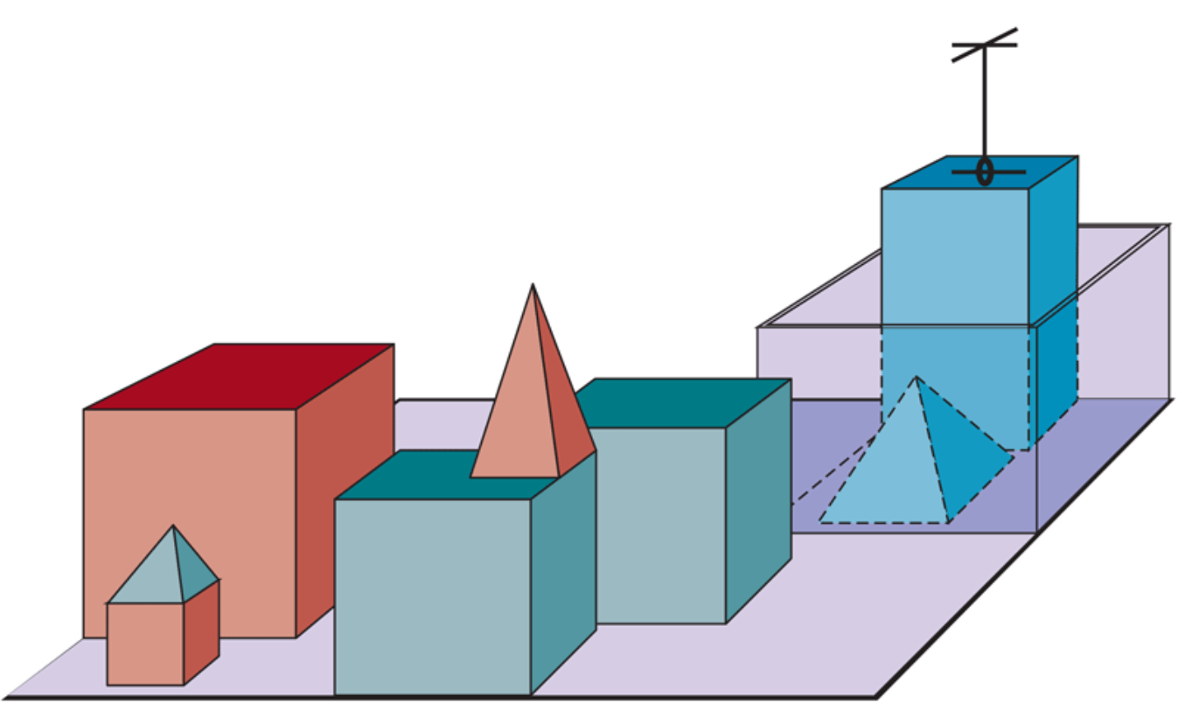
COMP 469 · Chapters 1 & 2 Expanded
Seven foundations: what each contributes
AI borrows tools and questions from many disciplines.
Philosophy
logic, ethics, mind
Mathematics
proof, probability, complexity
Economics
utility, games, decisions
Neuroscience
brains, neurons
Psychology
cognition, behavior
Linguistics
language structure
No single foundation is enough; intelligent agents need representation, uncertainty, learning, action, and computation.
Engineering
hardware, control
COMP 469 · Chapters 1 & 2 Expanded
Notes:
Use the blocks image as a metaphor: AI is assembled from multiple blocks. Students can think of each discipline as contributing a different design question. Philosophy: what is correct reasoning and ethical action? Mathematics: what can be proven or computed? Economics: how should preferences and tradeoffs be represented? Neuroscience and psychology: how do natural intelligent systems work? Linguistics: how is language structured? Engineering: how do we build reliable machines?

Slide 10
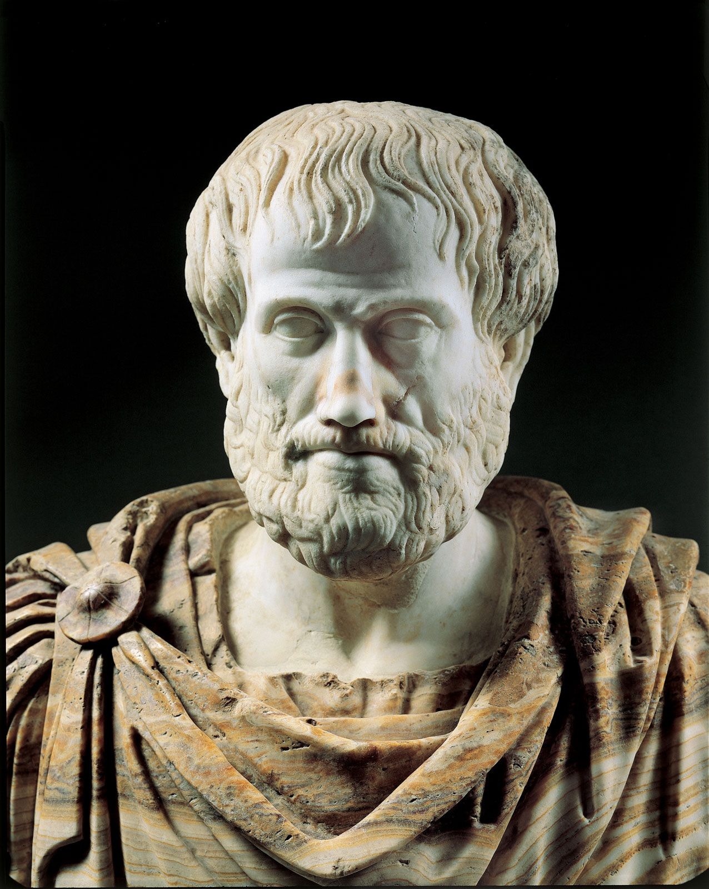
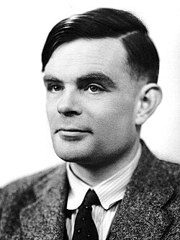
1.2 Foundations of AI — Seven Disciplines
Philosophy
Can formal rules draw valid conclusions? → Aristotle's syllogisms, logic
How does mind relate to brain? Dualism vs. materialism
Consequentialism (Mill) vs. Deontological ethics (Kant)
Mathematics
Formal logic (Boole → Frege → Gödel → Turing)
Probability theory: Bayes' rule, decision theory
Computability & tractability: Church-Turing thesis, NP-completeness
Economics
Expected utility maximization (Bernoulli, von Neumann)
Game theory for multiagent settings
Sequential decisions: MDPs (Bellman, 1957); satisficing (Simon)
Neuroscience + Psychology + Linguistics + Engineering
Neurons, Hebbian learning, brain-machine interfaces
Cognitive psychology: brain as information processor (Craik 1943)
Chomsky: language requires formal, learnable models
Computing hardware: Moore's Law, GPUs, TPUs
Notes:
Use this slide to show AI as an interdisciplinary field. Philosophy contributes logic and ethics; math contributes probability and computation; economics contributes utility and game theory; neuroscience and psychology inspire models; linguistics contributes language structure; engineering provides hardware and control. Students do not need mastery of every discipline now, but should recognize the sources of AI ideas.

Slide 11
1.2.2 Mathematical Foundations
Logic & Computation
Probability & Statistics
Boole (1847): Boolean / propositional logic
Frege (1879): first-order logic with objects & relations
Gödel incompleteness theorem (1931): some truths have no proof
Turing (1936): Church-Turing thesis; defines computability
Turing also proved some functions are uncomputable (halting problem)
Tractability: polynomial vs. exponential; NP-completeness (Cook 1971)
Cardano (1501): first formal probability
Bayes (1702): updating probabilities from evidence; Bayes' rule
Laplace, Bernoulli: statistical foundations
Fisher (1922): modern statistics; experiment design + analysis
Key insight: probability generalizes logic to uncertain worlds
Combined with data → modern ML and Bayesian networks
Notes:
Link logic, probability, and computation. Logic handles valid inference under certainty; probability handles uncertainty; computability and complexity tell us which problems can be solved and which are too expensive. This becomes important when students ask why we use heuristics or approximations.

Slide 12
1.3 History of AI – Key Eras
1943–56
Inception
GPS, LISP
Microworlds
1966–73
First Winter
DENDRAL, MYCIN
$billions
1986+
Neural Nets
Bayes nets
MDPs, RL
2011+
Deep Learning
McCulloch & Pitts
Dartmouth 1956
1952–69
Early Hype
Intractability
Lighthill report
1969–86
Expert Sys.
Backprop
Connectionism
1987+
Prob. Reason.
ImageNet, AlphaGo
LLMs
Turing Award Milestones
Minsky & McCarthy (1969, 1971) · Feigenbaum & Reddy (1994) · Judea Pearl (2011) · Bengio, Hinton, LeCun (2019)
Notes:
Tell the history as cycles of optimism, limits, and new tools. The lesson is not that one paradigm replaces all others forever; modern systems blend search, optimization, logic, probability, learning, and engineering. Dartmouth 1956 reference: https://home.dartmouth.edu/about/artificial-intelligence-ai-coined-dartmouth.

Slide 13
1.3 Inception & Early Enthusiasm (1943–1969)
1943: McCulloch & Pitts — artificial neuron model
Any computable function can be computed by a network of neurons
Logical connectives implementable with simple network structures
1950: Turing — 'Computing Machinery and Intelligence'
Introduced the Turing Test
Also introduced: machine learning, genetic algorithms, reinforcement learning
1956: Dartmouth Workshop — AI is officially 'born'
McCarthy coined the term 'Artificial Intelligence'
10 researchers; Newell & Simon presented Logic Theorist
1952–1969: Early successes
GPS: General Problem Solver — imitated human problem-solving
Checkers (Samuel): first program to outplay its creator via RL
LISP (McCarthy, 1958): dominant AI language for 30 years
Microworlds: SAINT (calculus), STUDENT (algebra), blocks world
Notes:
Highlight that early AI had impressive demonstrations in limited domains. Ask: why would blocks worlds, checkers, and algebra word problems be attractive early targets? Answer: small state spaces, clear rules, and easy scoring. Then transition to scaling problems.

Slide 14
1.3 Dose of Reality → Expert Systems (1966–1986)
First AI Winter (1966–1973)
Expert Systems (1969–1986)
Early systems worked on tiny problems; failed badly on harder ones
Combinatorial explosion: scaling up is not just faster hardware
Minsky & Papert (1969): perceptrons cannot represent XOR
Lighthill Report (1973): UK government ends AI funding
Lesson: general 'weak methods' don't scale
DENDRAL (1969): infer molecular structure from mass spectrometer data
MYCIN: 450 rules → diagnostic performance matching experts
R1 (DEC): saved $40M/year by 1986 configuring computer orders
AI industry: few million (1980) → billions (1988)
Second AI Winter: brittleness, inability to handle uncertainty, no learning
Notes:
Explain the first AI winter as a scaling lesson. Early systems looked intelligent in toy domains but often failed on real-world variability. Expert systems showed the power of domain knowledge but also brittleness and maintenance costs.

Slide 15
1.3 Modern AI: Neural Nets → Probabilistic → Deep Learning
1986: Backpropagation rediscovered → connectionist revolution
Parallel Distributed Processing (Rumelhart & McClelland)
Challenged symbolic AI; debate: symbols vs. distributed representations
1987+: Probabilistic reasoning & machine learning
Judea Pearl (1988): Bayesian networks — rigorous uncertain reasoning
Rich Sutton: reinforcement learning + MDPs unified
Speech recognition: HMMs dominate; data-driven, mathematically grounded
Benchmark datasets: ImageNet, SQuAD, LibriSpeech become standard
2001+: Big Data + Deep Learning
Millions of images, billions of words → learning algorithms flourish
2012 ImageNet: Hinton's group CNN — dramatic leap over prior systems
AlphaGo (2016) beats world Go champion; AlphaZero: purely self-play
2017: Microsoft achieves human parity on Switchboard speech recognition
Notes:
Explain the shift from hand-coded knowledge to data-driven learning, and from shallow pipelines to learned representations. Mention that deep learning did not remove the need for agents, objectives, safety, search, or environment analysis; it changed how parts of the agent can be implemented.

Slide 16
1.4 State of the Art — What AI Can Do Today
Perception & Language
Object recognition: error rate 28% (2010) → 2% (2017) — beats humans
Speech recognition: word error rate 5.1%, matching human performance (2017)
Machine translation: 100+ languages, 99% of humans' native tongues
Question answering (SQuAD): F1 score 95, exceeds human benchmark
Reasoning & Decision Making
Chess (Deep Blue, 1997), Go (AlphaGo, 2016), Poker, StarCraft II, Dota 2
Autonomous planning: NASA Remote Agent; DART saved 30 years of DARPA investment
Robotic vehicles: Waymo at 10M miles; autonomous drones delivering blood in Rwanda
Science & Medicine
AI ≥ expert doctors at diagnosing Alzheimer's, metastatic cancer, skin disease
Human-AI partnerships outperform either alone (LYNA: 99.6% accuracy)
AlphaFold: protein structure prediction — decades-old biology challenge solved
Deep learning models detect extreme weather patterns buried in climate data
Notes:
Give examples but avoid overclaiming general intelligence. AI systems can exceed humans in narrow tasks, yet fail under distribution shift, adversarial examples, ambiguous goals, or missing context. Ask students to name one task where AI is strong and one where it remains risky.

Slide 17
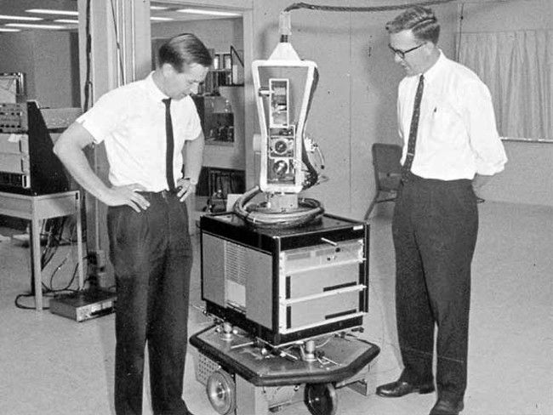
From symbols to action: Shakey the Robot
Early AI connected perception, planning, and movement.
• SRI project, 1966–1972
• Combined vision, planning, navigation, and action
• Reasoned about its own actions in rooms with blocks and ramps
• Historically important even though it was not a practical household robot
Why it matters: an AI agent is not just a model; it acts in an environment.
COMP 469 · Chapters 1 & 2 Expanded
Notes:
Use Shakey to connect Chapter 1 history to Chapter 2 agents. Shakey was significant because it integrated sensing, planning, and action in a physical environment. It illustrates the agent loop before modern deep learning. Reference: Computer History Museum, Shakey, https://www.computerhistory.org/revolution/artificial-intelligence-robotics/13/289; IEEE Milestone article, https://ethw.org/Milestones%3ASHAKEY%3A_The_World%E2%80%99s_First_Mobile_Intelligent_Robot%2C_1972. Image source used: https://robogeek.ru/files/blogs/0004/2301/_cache/fit650x800-shakey.jpg.

Slide 18
1.5 Risks and Benefits of AI
Benefits
Risks
Free humanity from menial, repetitive work
Dramatically increase production of goods and services
Accelerate scientific research: cures, climate solutions
Demis Hassabis: 'First solve AI, then use AI to solve everything else'
Medical AI already equals or exceeds specialists in several diagnostics
AI helps 100M+ people daily with navigation, translation, recommendations
Lethal autonomous weapons: scalable, no human supervision required
Mass surveillance: speech/vision AI enables real-time monitoring at scale
Biased decision making: parole, loans — reflecting and amplifying societal bias
Employment disruption: shifts wealth from labor to capital
Safety-critical failures: self-driving fatal accidents; formal verification gaps
Cybersecurity: RL-powered phishing/blackmail; automated malware
Notes:
Use benefits and risks as design pressure, not as a side topic. The same agent framework helps analyze both: what objective is optimized, what sensors are available, what actions are possible, and what performance measure is being used? References: NIST AI RMF and OECD AI Principles.

Slide 19
Chapter 1 Summary
AI's goal: build agents that act rationally — maximizing expected performance given an objective.
Four historical approaches: acting/thinking humanly vs. rationally. The rational agent approach dominates.
Value alignment: machines pursuing a fixed objective can cause harm; future AI must handle uncertain objectives.
Seven founding disciplines: Philosophy, Mathematics, Economics, Neuroscience, Psychology, Linguistics, CS.
History follows cycles: enthusiasm → failure → new approach. Deep learning is the latest revolution.
State of the art: AI now matches or exceeds humans in perception, translation, diagnosis, and complex games.
Risks are real: autonomous weapons, surveillance, bias, employment disruption, misaligned superintelligence.
Notes:
Use this summary as a retrieval check. Ask students to close notes and reconstruct the four approaches to AI. Then ask which approach best matches the rest of the course. Answer: rational agents, with attention to safety and limited computational resources.

Slide 20
PART 2
Chapter 2: Intelligent Agents
Notes:
Transition: Chapter 1 gives the big picture; Chapter 2 gives the central abstraction. From now on, many problems will be described as an agent in an environment receiving percepts and producing actions.

Slide 21
Chapter 2 — What We'll Cover
2.1 Agents and Environments
Percepts, actions, and the agent function
Why lookup tables fail
2.2 Good Behavior: Rationality
Performance measures and the definition of rationality
Rationality vs. omniscience; autonomy and learning
2.3 Task Environments (PEAS)
Specifying the task environment
Seven key dimensions every AI designer must consider
2.4 Agent Architectures
Simple Reflex → Model-Based → Goal-Based → Utility-Based → Learning
Atomic, Factored, and Structured representations
Notes:
Preview Chapter 2. The most important vocabulary for Lab 01 is: agent, percept, action, performance measure, PEAS, environment dimensions, and agent architecture. Tell students these terms will appear in assignments and exams.

Slide 22
2.1 What Is an Agent?
An agent perceives its environment through sensors and acts upon it through actuators
Examples
Human → eyes/ears, hands/voice
Robot → cameras/lidar, motors
Software agent → file/network inputs, file writes/API calls
Percept & Percept Sequence
Percept = content the sensors are perceiving right now
Percept sequence = complete history of all past percepts
Agent's action may depend on the entire percept history
Agent Function vs. Agent Program
Agent function: abstract math — maps percept sequence → action
Agent program: concrete implementation on hardware
Same agent function; many possible programs
Notes:
Distinguish the agent from the environment. Sensors provide percepts; actuators produce actions. The agent function maps percept sequences to actions; the agent program implements the function on hardware. This distinction matters when comparing abstract behavior to code.

Slide 23
2.1 Why a Lookup Table Fails
A table-driven agent explicitly stores the correct action for every possible percept sequence
The table is astronomically large
Taxi with 8 cameras at 70 MB/s → > 10⁶⁰⁰,⁰⁰⁰,⁰⁰⁰ entries per hour
Chess alone: at least 10¹⁵⁰ entries
Observable atoms in the universe: < 10⁸⁰
Three practical failures
No physical agent has space to store the table
No designer has time to construct it
No agent could learn all entries from experience
The central AI challenge: write compact programs that produce rational behavior — like Newton's method replaced printed square-root tables
Notes:
Make the lookup table problem concrete. Even a simple percept vocabulary grows exponentially with sequence length. The goal of AI design is to write compact programs that generalize across percept sequences rather than memorizing every possible history.

Slide 24
2.2 Rationality — The Four Factors
What determines rational action?
1. The performance measure; criterion of success
2. Prior knowledge of the environment
3. The actions the agent can perform
4. The agent's percept sequence to date
Definition
A rational agent selects the action that maximizes expected performance given its percept sequence and built-in knowledge
Performance measure design pitfalls
Measure 'dirt cleaned' → agent dumps and re-cleans to game the score
Better: reward clean floor at each time step
General rule: measure what you actually want, not how you expect the agent to behave
Related to the King Midas / value alignment problem from Ch. 1
Notes:
The four rationality factors are the backbone: performance measure, percept sequence, prior knowledge, and available actions. Emphasize that rationality is judged relative to what the agent has perceived and what it can do, not with hindsight.

Slide 25
2.2 Rationality vs. Omniscience vs. Autonomy
Rationality
Omniscience / Autonomy
Maximizes expected performance given available information
Does NOT require knowing the actual outcome
Information gathering is part of rational behavior
Must learn from percepts to improve over time
'Look both ways before crossing' is rationally required even if no truck is coming
Omniscient = knows the actual outcome — impossible in reality
Rationality ≠ perfection (cargo door example)
Autonomy = relying on own learning, not just designer's prior knowledge
Rational agents should learn to compensate for incomplete priors
Sphex wasp: lacks autonomy → repeats failed plan forever
Notes:
Rationality is not omniscience. A rational agent maximizes expected performance, not guaranteed actual performance. Autonomy means the agent can learn from experience instead of relying only on designer assumptions. Use the crossing-the-street example or the sphex wasp story from Chapter 2.

Slide 26
2.3 PEAS: Specifying the Task Environment
P — Performance Measure
What does success look like? (safety, speed, profit, comfort…)
E — Environment
What does the agent operate in? (roads, weather, passengers…)
A — Actuators
How does the agent act? (steering, braking, display, voice…)
S — Sensors
How does the agent perceive? (cameras, lidar, GPS, microphone…)
Automated Taxi Example
Performance: correct destination, safety, fuel, legality, comfort
Environment: roads, traffic, pedestrians, weather, passengers
Actuators: accelerator, brakes, steering, horn, touchscreen display
Sensors: cameras, lidar, ultrasound, speedometer, GPS, touchscreen input
Notes:
PEAS is the first design step. Have students use the acronym aloud: Performance, Environment, Actuators, Sensors. Point out that changing one PEAS component can change the best agent architecture.

Slide 27
COMP 469 · Chapters 1 & 2 Expanded
Performance measures score histories, not intentions
A rational agent optimizes what you measure.
Performance measure
Bad design
Good design
A function that evaluates a sequence of environment states.
Reward easy proxy → agent exploits proxy
Reward desired world state → agent aligns better
In AI, 'what you ask for is what you get' — sometimes painfully literally.
COMP 469 · Chapters 1 & 2 Expanded
Notes:
Make the idea consequential. A performance measure is not a motivational slogan; it is the scoring rule. The vacuum example makes this clear: measuring dirt collected can reward perverse behavior, while measuring clean squares over time better captures the desired state. This is an early version of the objective specification problem discussed in Chapter 1.

Slide 28
2.3 Properties of Task Environments
Fully Observable
Partially Observable
Static
Dynamic
Single-Agent
Multiagent
Discrete
Continuous
Deterministic
Nondeterministic
Known
Unknown
Episodic
Sequential
Taxi driving is hard in all 7 dimensions!
Notes:
Use examples: chess is fully observable, deterministic, sequential, static, discrete, known, multiagent. Taxi driving is partially observable, stochastic, sequential, dynamic, continuous, and multiagent. These dimensions predict what algorithms will be appropriate later.

Slide 29
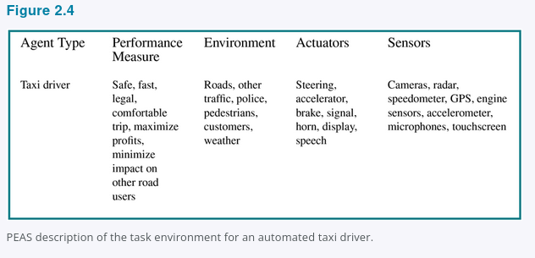
COMP 469 · Chapters 1 & 2 Expanded
PEAS example: Automated taxi
A realistic PEAS description is more complicated than the vacuum world.
• Performance includes safety, legality, comfort, time, and profit
• Environment includes roads, pedestrians, weather, maps, and traffic
• Actuators include steering, braking, acceleration, signals, horn
• Sensors include cameras, lidar/radar, GPS, speedometer, engine sensors
COMP 469 · Chapters 1 & 2 Expanded
Notes:
Use the taxi as the contrast case. It is partially observable, stochastic, dynamic, continuous, sequential, and multiagent. That makes it dramatically harder than the vacuum world. Source image/table: uploaded Chapter 2, Figure 2.4. Ask students which PEAS component is hardest to specify. Usually performance is hardest because it involves tradeoffs among safety, time, comfort, and cost.

Slide 30
2.4 Agent Type 1
Simple Reflex Agent
Selects actions based solely on the current percept; ignores percept history entirely. Uses condition-action rules: if car-in-front-is-braking → initiate-braking.
Key Characteristics:
Key Idea
No internal state — stateless
Only works in fully observable environments
Prone to infinite loops when partially observable
Randomization can sometimes help escape loops
Example: basic vacuum agent (Dirty→Suck, else move)
Simple and fast, but fragile. Fails whenever the current percept alone is not enough to determine the correct action.
Notes:
Simple reflex agents are rules over current percepts. They are fast and easy to explain, but brittle when the current percept does not contain all relevant information. Connect to thermostats and the reflex vacuum agent in Lab 01.

Slide 31
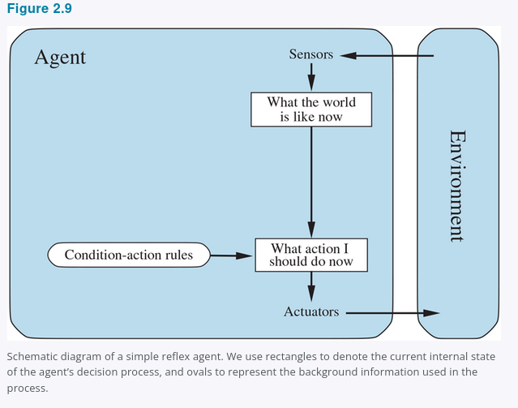
COMP 469 · Chapters 1 & 2 Expanded
Agent type 1: Simple reflex
Fast rule-based behavior, but no memory.
• Condition-action rules
• Uses only current percept
• Works when current percept contains enough information
• Fails in partially observable or changing worlds
Thermostat rule: IF temperature < target THEN heat ON.
COMP 469 · Chapters 1 & 2 Expanded
Notes:
Use the figure to show the simple reflex architecture. It has no internal state; it chooses an action based on the current percept. This is often good enough for simple, fully observable conditions. In Lab 01, a simple reflex vacuum agent can follow a fixed rule, but it cannot remember where it has already cleaned unless that information is part of the current percept. Source image: uploaded Chapter 2, Figure 2.9.

Slide 32
2.4 Agent Type 2
Model-Based Reflex Agent
Maintains an internal state to track parts of the world it cannot currently observe. Uses a transition model (how the world changes) and a sensor model (how state is reflected in percepts).
Key Characteristics:
Key Idea
Maintains internal state — handles partial observability
Transition model: effects of actions + world evolution
Sensor model: maps world state to percepts
Updates internal state with each new percept
Example: taxi tracking positions of occluded vehicles
Keeps a 'best guess' of world state. Enables smarter behavior in partially observable environments where the current percept alone is insufficient.
Notes:
Model-based agents add memory. The internal state is a summary of the percept history, not magic access to the whole world. In Lab 01, a model-based vacuum agent stores visited squares and known dirt status.

Slide 33
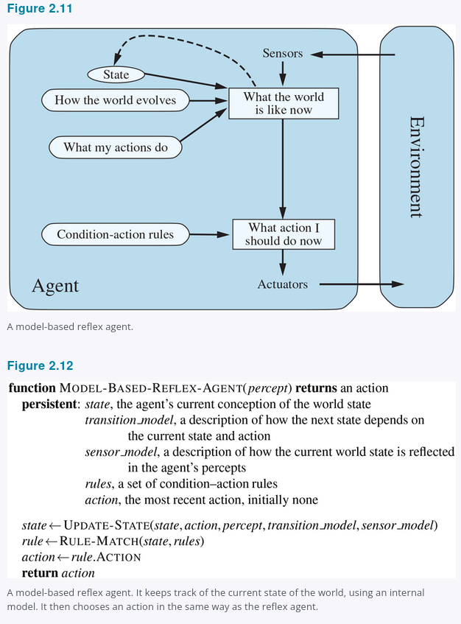
COMP 469 · Chapters 1 & 2 Expanded
Agent type 2: Model-based reflex
Memory turns percepts into an internal state.
• Maintains internal state
• Uses a model of how the world changes
• Uses a model of how actions affect the world
• Handles partial observability better than simple reflex
Lab link: visited squares + known dirt status = internal model.
COMP 469 · Chapters 1 & 2 Expanded
Notes:
Explain that the model summarizes the percept sequence. A model-based agent does not necessarily know the real state; it stores its best estimate based on what it has perceived and how it believes the world changes. In the lab, a visited set and known-status dictionary are the first form of a model. Source image: uploaded Chapter 2, Figure 2.11.

Slide 34
2.4 Agent Type 3
Goal-Based Agent
Combines a world model with explicit goal information describing desired situations. Uses search (Ch. 3–5) or planning (Ch. 11) to find action sequences that achieve the goal.
Key Characteristics:
Key Idea
Explicit goal representation
Considers future consequences of actions
Requires search or planning algorithms
More flexible: change the goal → behavior changes automatically
Example: taxi navigating to a destination
Unlike reflex agents, goal-based agents ask: 'What will happen if I do X? Will that achieve my goal?' Knowledge is explicit and modifiable.
Notes:
Goal-based agents ask: what future state am I trying to reach? They often require search or planning. This slide prepares students for Chapter 3, where actions are organized into paths from start to goal.

Slide 35
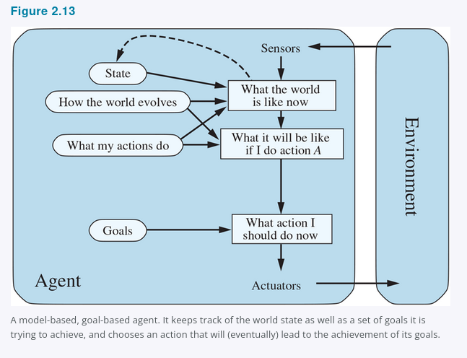
COMP 469 · Chapters 1 & 2 Expanded
Agent type 3: Goal-based
Goals let the agent compare future possibilities.
• Represents desired future states
• Uses search or planning
• Can adapt when the goal changes
• Less reactive, more flexible
Lab link: find the nearest dirty square using BFS.
COMP 469 · Chapters 1 & 2 Expanded
Notes:
Goal-based agents are the bridge to Chapter 3 search. The agent asks: which action sequence gets me to a goal state? In the vacuum lab, the goal-based agent can compute a path to the nearest dirty square. Make clear that goals alone do not handle tradeoffs such as risk, cost, or preference among multiple good outcomes. Source image: uploaded Chapter 2, Figure 2.13.

Slide 36
2.4 Agent Type 4
Utility-Based Agent
Uses a utility function to compare world states — going beyond binary goal/no-goal to a graded measure of desirability. Maximizes expected utility across uncertain outcomes.
Key Characteristics:
Key Idea
Utility function = internalized performance measure
Handles conflicting goals via principled tradeoffs
Handles uncertainty: weighs likelihood × importance of outcomes
Maximizes expected utility over probabilistic outcomes
Example: taxi balancing speed, safety, and passenger comfort
Goals give binary happy/unhappy; utility gives a continuous measure. Essential when goals conflict or outcomes are uncertain.
Notes:
Utility-based agents handle tradeoffs and uncertainty. Goals are often too crude; utility lets the agent compare speed vs. safety, cost vs. quality, or risk vs. reward. This is the foundation for later decision theory and reinforcement learning.

Slide 37
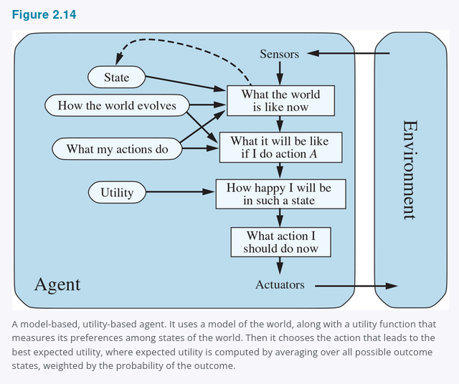
COMP 469 · Chapters 1 & 2 Expanded
Agent type 4: Utility-based
Utilities compare tradeoffs when goals are not enough.
• Ranks outcomes by desirability
• Handles conflicting goals
• Handles uncertain outcomes
• Chooses actions that maximize expected utility
Example: fastest route is not always best if risk, comfort, and legality matter.
COMP 469 · Chapters 1 & 2 Expanded
Notes:
Utility-based agents are essential when there are tradeoffs. A taxi may have a goal of reaching the destination, but utility compares routes that differ in time, risk, comfort, legality, and fuel. Under uncertainty, the agent maximizes expected utility. This previews Chapters 16–17. Source image: uploaded Chapter 2, Figure 2.14.

Slide 38
2.4 Agent Type 5: Learning Agent
Four Components
Performance Element — selects external actions (what we've described so far)
Learning Element — improves performance using feedback from the critic
Critic — evaluates performance against a fixed external standard
Problem Generator — suggests exploratory actions to discover new information
Key advantages
Operates in initially unknown environments
Becomes more competent than initial knowledge alone allows
Can improve any component: reflex rules, world model, utility function
Exploration vs. Exploitation
Problem generator: short-term suboptimal actions → long-term better policy
Analogous to Galileo's experiments — deliberate exploration to update beliefs
Taxi: unexpected braking on wet roads → updates deceleration model
Notes:
The learning agent diagram shows how an agent improves over time. The performance element chooses actions; the critic evaluates outcomes; the learning element updates behavior; the problem generator encourages exploration.

Slide 39
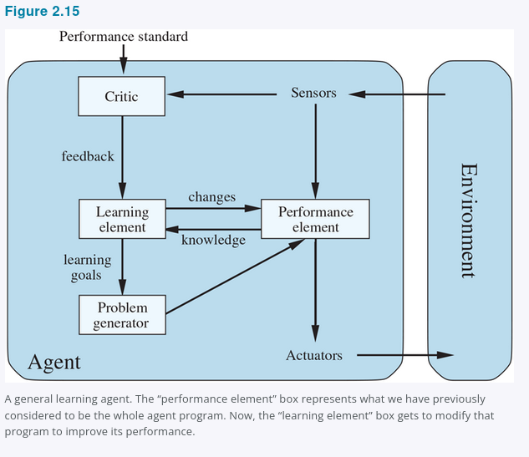
COMP 469 · Chapters 1 & 2 Expanded
Agent type 5: Learning agent
Learning lets the agent improve from experience.
• Performance element: chooses actions
• Critic: evaluates performance
• Learning element: improves the agent
• Problem generator: encourages exploration
Learning is how agents become more autonomous over time.
COMP 469 · Chapters 1 & 2 Expanded
Notes:
Use the learning agent diagram to show how improvement is structured. The performance element is what acts now; the learning element changes the performance element; the critic supplies feedback; the problem generator suggests exploratory actions. Source image: uploaded Chapter 2, Figure 2.15. Connect to reinforcement learning later in the course.

Slide 40
2.4.7 Representation: Atomic → Factored → Structured
Atomic Representation
World state = single indivisible 'black box'
Used in: search algorithms (Ch. 3–5), HMMs (Ch. 14), MDPs (Ch. 17)
Example: city name in a route-planning problem
Factored Representation
State = fixed set of variables/attributes with values
States can share attribute values → easier to reason about differences
Used in: CSPs, propositional logic, Bayesian networks, planning, most ML
Example: GPS location, fuel level, oil warning light, toll money
Structured Representation
Objects and their explicit relationships described formally
Used in: relational databases, first-order logic, NLP
Far more expressive but harder to reason with
Example: 'loose cow blocking truck reversing into dairy farm driveway'
Notes:
Representation determines what an agent can say about the world. Atomic representations treat each state as a black box; factored representations use variables; structured representations model objects and relations. This foreshadows CSPs, logic, Bayesian networks, and first-order logic.

Slide 41
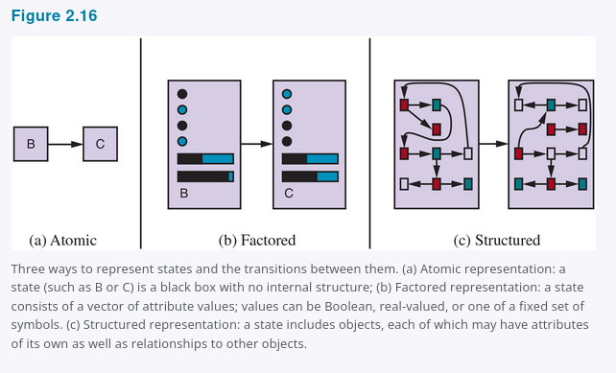
COMP 469 · Chapters 1 & 2 Expanded
Representations: atomic → factored → structured
More expressiveness usually means harder reasoning.
• Atomic: each state is a black box
• Factored: states have variables and values
• Structured: objects and relations
• Choose the least expressive representation that solves the task
This ladder previews CSPs, logic, probabilistic models, planning, and machine learning.
COMP 469 · Chapters 1 & 2 Expanded
Notes:
This slide shows why representation is a central AI question. Atomic states are simple but do not share structure. Factored states allow reasoning over variables. Structured representations allow objects and relations, which become central in first-order logic. Source image: uploaded Chapter 2, Figure 2.16.

Slide 42
Full Lecture Summary — Chapters 1 & 2
AI = building rational agents that maximize expected performance; the 'standard model' is shared with economics, control theory, and statistics.
Four historical approaches: the rational agent view dominates because it is mathematically well-defined and general.
Value alignment is AI's central unsolved problem: a fixed objective in a capable system can cause unintended harm.
AI history cycles between enthusiasm and winters; deep learning is the current revolution; transformers, GPUs, big data.
Today: AI meets or exceeds humans in perception, translation, game-playing, and specialized medical diagnosis.
An agent's behavior = agent function (abstract) + agent program (concrete). Lookup tables are infeasible; compact programs are the goal.
Task environments are characterized via PEAS and seven dimensions: observable, agents, determinism, episodic, static, discrete, known.
Five agent types of increasing sophistication: Simple Reflex → Model-Based → Goal-Based → Utility-Based → Learning Agent.
Representations scale in expressiveness: Atomic → Factored → Structured; more expressive = harder reasoning.
Notes:
Use this full summary for exam preparation. Ask students to identify which bullets belong to Chapter 1 and which belong to Chapter 2. Then ask them to explain how value alignment connects to performance measures.

Slide 43
Questions?
Next lecture: Chapter 3 — Solving Problems by Searching
BFS, DFS, UCS, A* heuristic search — the backbone of classical AI planning
COMP 469 · Artificial Intelligence · CSU Channel Islands
Notes:
Pause for questions. Suggested prompt: choose an AI system you use and describe its sensors, actuators, environment, and likely performance measure. This prepares students for the expanded examples that follow.

Slide 44
COMP 469 · Chapters 1 & 2 Expanded
Expanded Teaching Slides
Examples, instructor notes, visuals, and classroom checks for Chapters 1 & 2
Use these after the core lecture or interleave them with the original slides.
COMP 469 · Chapters 1 & 2 Expanded
Notes:
This divider marks the supplemental section. You can teach these slides after the original deck or move them into the relevant sections. They are designed to make abstract ideas concrete through examples, diagrams, and student checks. The notes include suggested prompts and answers.

Slide 45
COMP 469 · Chapters 1 & 2 Expanded
What students should be able to do
By the end of Chapters 1 & 2, students should speak the language of AI agents.
• Define AI using the rational-agent view
• Explain the four historical approaches to AI
• Describe why objectives and performance measures matter
• Specify a task environment using PEAS
• Classify an environment and choose an agent architecture
• Connect lecture ideas to the Vacuum World lab
Evaluate
Design
Classify
Specify
Define
A student who can do these five verbs can analyze most AI systems at a high level.
COMP 469 · Chapters 1 & 2 Expanded
Notes:
Teaching goal: make the outcomes explicit. A useful opening question is: what would it mean to 'understand AI' after only two chapters? The answer is not that students can build GPT or a robot yet. It means they can describe an AI system as an agent with sensors, actions, objectives, and environmental constraints. Ask students which objective they feel least confident about; revisit it during the lecture.

Slide 46
COMP 469 · Chapters 1 & 2 Expanded
AI is a universal field, not one tool
Chapter 1 frames AI as relevant to any intellectual task, from perception to decision making.
Reasoning
Learning
Language
Artificial Intelligence
Perception
Robotics
Planning
The course unifies these areas with the agent idea: perceive → decide → act → learn.
COMP 469 · Chapters 1 & 2 Expanded
Notes:
Use this slide to prevent a common misconception: AI is not just chatbots or neural networks. Chapter 1 lists learning, reasoning, perception, chess, theorem proving, poetry, driving, and diagnosis as AI tasks. The unifying question is action selection: what should the system do next to perform well? Ask students to map an everyday app to one or more circles on the slide.

Slide 47
COMP 469 · Chapters 1 & 2 Expanded
Four approaches through one example
Example system: an AI campus tutoring assistant.
Acting humanly
Thinking humanly
Can students tell it is not a human tutor?
Does it make mistakes and reasoning steps like a student?
Thinking rationally
Acting rationally
Does it derive valid answers from rules and facts?
Does it choose actions that improve learning outcomes?
Course emphasis: acting rationally
COMP 469 · Chapters 1 & 2 Expanded
Notes:
This slide makes the 2-by-2 framework concrete. Students often memorize the four labels without understanding the difference. Use one tutoring assistant to compare them. The same system can be evaluated four ways: by human-likeness, cognitive fidelity, logical validity, or expected educational impact. Stress that AIMA's dominant approach is the rational-agent approach because it supports mathematically precise design.

Slide 48
COMP 469 · Chapters 1 & 2 Expanded
The Turing Test becomes a capability checklist
Passing a serious imitation game would require much of AI.
Key teaching point: Turing proposed a test of behavior, not a full theory of intelligence.
Written Turing Test
Robotics
Computer vision
Machine learning
Total Turing Test
Automated reasoning
Adds perception and physical action.
Knowledge representation
Natural language processing
COMP 469 · Chapters 1 & 2 Expanded
Notes:
Explain that the Turing Test is historically important because it reframes 'Can machines think?' as an observable test. However, it is not the main engineering objective of the course. A system could imitate humans yet be unsafe or inefficient; another system could be superhuman in a narrow task without imitating humans. Reference: Turing, A. M. (1950), Computing Machinery and Intelligence, https://doi.org/10.1093/mind/LIX.236.433.

Slide 49
COMP 469 · Chapters 1 & 2 Expanded
The rational-agent design loop
The central engineering question: what action should be chosen now?
Percepts
Agent program
Actions
Environment
Performance measure
Rationality is local to what the agent has perceived and what actions are available.
COMP 469 · Chapters 1 & 2 Expanded
Notes:
Walk through the loop slowly. The environment produces percepts through sensors. The agent program transforms the percept sequence plus internal state into an action. The environment changes, and the performance measure evaluates the resulting sequence of states. Make clear that the performance measure is external: it is how the designer or user scores the agent, not necessarily what the code explicitly stores.

Slide 50
COMP 469 · Chapters 1 & 2 Expanded
The standard model: objective → optimization
Powerful agents amplify both good objectives and bad objectives.
Objective
Optimizer
Actions
World impact
Failure mode
When the objective is only a proxy for what humans actually value, optimization can produce unintended behavior.
COMP 469 · Chapters 1 & 2 Expanded
Notes:
This slide connects Chapter 1 alignment to Chapter 2 performance measures. The standard model is powerful: define an objective and build a system to maximize it. The risk is proxy failure. Use a simple example: a system rewarded for engagement may maximize outrage; a cleaning robot rewarded for dirt collected might spread dirt. The more capable the optimizer, the less forgiving a flawed objective becomes. References: NIST AI RMF https://www.nist.gov/itl/ai-risk-management-framework; OECD AI Principles https://www.oecd.org/en/topics/ai-principles.html.

Slide 51
COMP 469 · Chapters 1 & 2 Expanded
Alignment starts with tiny examples
The vacuum world shows why measuring the right thing matters.
Bad performance measure
Better performance measure
Reward: amount of dirt sucked up. Problem: the rational agent may dump dirt and clean it repeatedly.
Reward: clean squares over time. Optional penalties: movement, noise, energy, damage, time.
Design rule
Measure the state of the world you want, not just the behavior you expect.
COMP 469 · Chapters 1 & 2 Expanded
Notes:
This is the bridge between abstract AI safety and the first programming lab. Ask students: If I pay a robot per piece of trash picked up, what could go wrong? Then ask: what would a better measure look like? The Chapter 2 answer is to evaluate the sequence of environment states: is the floor clean over time, and at what cost? This will help students understand why performance measures are central to rationality.

Slide 52
COMP 469 · Chapters 1 & 2 Expanded
Three mathematical pillars
Logic, probability, and complexity become recurring course tools.
Logic
Probability
Complexity
When knowledge is certain, derive conclusions that must follow.
When information is uncertain, update beliefs from evidence.
When exact computation is too expensive, use heuristics and approximation.
Later chapters reuse these pillars: search, logic, Bayesian networks, planning, MDPs, and learning.
COMP 469 · Chapters 1 & 2 Expanded
Notes:
The purpose is to show why the foundations are not historical trivia. Logic appears in knowledge-based agents. Probability appears when sensors are noisy or the world is partially observable. Complexity explains why perfect rationality is often impossible; agents must be bounded by computation time. Ask students which pillar best fits a self-driving car. The answer is all three.

Slide 53
COMP 469 · Chapters 1 & 2 Expanded
From certainty to uncertainty
AI needs both valid inference and uncertain inference.
Logic true/false
Probability degrees of belief
Decision theory beliefs + utilities
• Logic: if premises are true, the conclusion must be true
• Probability: belief changes with evidence
• Decision theory: choose actions using probabilities and utilities
COMP 469 · Chapters 1 & 2 Expanded
Notes:
This slide previews the course progression. Early chapters use search and logic in simplified worlds. Later chapters add probability because real sensors and human goals are uncertain. A rational agent generally needs both beliefs and preferences: What is likely to happen? How good or bad would that outcome be? This slide also helps students see why AI is broader than machine learning.

Slide 54
COMP 469 · Chapters 1 & 2 Expanded
AI history is a sequence of lessons
Each era kept some ideas and exposed new limits.
1940s–50s
1950s–60s
1970s
1980s
1990s
2000s+
2010s+
AI can be formalized
Toy problems are solvable
Scaling is hard
Knowledge matters
Uncertainty matters
Data + compute matter
Representation learning scales
The pattern: enthusiasm → limits → new representation or algorithm → broader success.
COMP 469 · Chapters 1 & 2 Expanded
Notes:
Tell the history as engineering learning, not a list of dates. Students should remember the lesson behind each era: formalization, toy success, combinatorial explosion, domain knowledge, probabilistic reasoning, big data, and deep learning. This historical perspective prevents 'new technique solves everything' thinking. Reference for Dartmouth 1956: https://home.dartmouth.edu/about/artificial-intelligence-ai-coined-dartmouth.

Slide 55
COMP 469 · Chapters 1 & 2 Expanded
Expert systems: powerful, but brittle
Domain knowledge can outperform general weak methods—until the world changes.
Facts
Inference engine
Advice
Rules
• Strength: explainable rule-based decisions
• Weakness: expensive knowledge engineering
• Weakness: brittle outside encoded cases
COMP 469 · Chapters 1 & 2 Expanded
Notes:
Expert systems are a good example of the importance of representation. They succeeded by encoding expert knowledge in rules, but they were difficult to build and maintain. Ask students to imagine a medical expert system: what happens when a new disease variant appears or a symptom is missing? This prepares them for later knowledge representation chapters and for understanding why data-driven learning became attractive.

Slide 56
COMP 469 · Chapters 1 & 2 Expanded
Deep learning: learned representations
Modern AI often learns features instead of hand-coding them.
Input
Features
Hidden layers
Prediction / action
• Less manual feature engineering
• Needs data, compute, and careful evaluation
• Still embedded inside an agent with objectives and actions
• Can be brittle under distribution shift
COMP 469 · Chapters 1 & 2 Expanded
Notes:
Emphasize balance. Deep learning is a major AI success, especially for perception and language, because it learns internal representations from data. But it does not erase Chapter 2. A learned model is usually part of a larger agent architecture: sensors collect data, the model estimates something, the agent chooses actions, and the performance measure determines success. This helps students avoid reducing all AI to neural networks.

Slide 57
COMP 469 · Chapters 1 & 2 Expanded
State of the art: capability is not the same as robustness
A system can be excellent on a benchmark and still fail in deployment.
High capability
Remaining limits
Image recognition, speech recognition, translation, game playing, code generation, protein-structure prediction.
Out-of-distribution data, causal reasoning, long-horizon planning, uncertainty calibration, value alignment, verification.
Class question: What would you test before deploying an AI agent in the real world?
COMP 469 · Chapters 1 & 2 Expanded
Notes:
This slide makes the state-of-the-art discussion careful. A model can do very well on a benchmark but still be unsafe if the task environment changes. Prompt students to identify tests: edge cases, adversarial examples, fairness checks, human oversight, uncertainty estimates, and monitoring after deployment. Reference examples: IBM Deep Blue https://www.ibm.com/history/deep-blue; AlphaGo paper https://www.nature.com/articles/nature16961; DeepMind AlphaGo overview https://deepmind.google/research/alphago/.

Slide 58
COMP 469 · Chapters 1 & 2 Expanded
Risk analysis: ask agent-design questions
Safety and ethics are easier to discuss when we name the agent pieces.
Objective
Sensors
Actions
What exactly is being optimized?
What is missing, noisy, or biased?
What can the system change?
Environment
Oversight
Learning
Who else is affected?
Can humans intervene or audit?
How does behavior change over time?
Use PEAS before deployment, not after harm occurs.
COMP 469 · Chapters 1 & 2 Expanded
Notes:
Use this as a practical safety checklist. It is intentionally tied to Chapter 2 vocabulary. Students should learn that ethics is not separate from technical design: objectives, sensors, actions, environment assumptions, and learning dynamics all create risk. References for responsible AI frameworks: NIST AI Risk Management Framework, https://www.nist.gov/itl/ai-risk-management-framework; OECD AI Principles, https://www.oecd.org/en/topics/ai-principles.html.

Slide 59
COMP 469 · Chapters 1 & 2 Expanded
Chapter 2: the core agent vocabulary
Everything later in the course can be described using these terms.
Agent
perceives + acts
Percept sequence
history of inputs
Agent function
percepts → action
Performance measure
scores outcomes
PEAS
task specification
Environment dimensions
design constraints
Agent architecture
program structure
These words let students discuss any AI system without jumping straight to code.
COMP 469 · Chapters 1 & 2 Expanded
Notes:
This slide introduces the vocabulary that students must use in Lab 01 and exams. Ask them to pick a familiar system—Google Maps, a spam filter, a robot vacuum, a recommender—and label each term. The point is to move from vague statements like 'the AI knows' to precise statements about percepts, internal state, action, and performance.

Slide 60
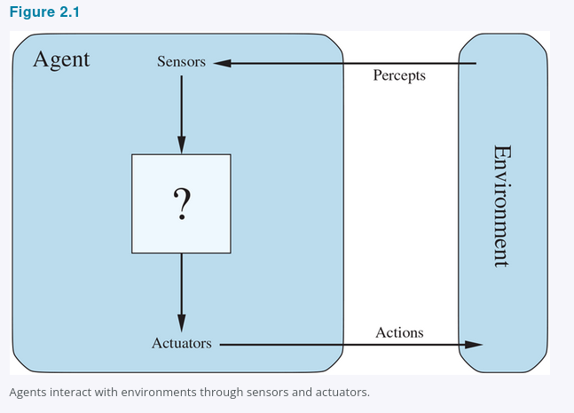
COMP 469 · Chapters 1 & 2 Expanded
Agent = sensors + program + actuators
The environment both influences and is influenced by the agent.
• Sensors turn environment state into percepts
• The agent program chooses actions
• Actuators affect the environment
• The loop repeats over time
Important: the agent usually sees only part of the environment.
COMP 469 · Chapters 1 & 2 Expanded
Notes:
Use the textbook's agent-environment diagram. Students should not think of AI as a one-shot prediction function. The agent repeatedly receives percepts and acts. This is why the complete percept sequence matters. Ask: what are the sensors and actuators for a spam filter? Sensors could be email text, sender, links; actuators could be labeling, moving, warning, or deleting. Source image: uploaded Chapter 2, Figure 2.1.

Slide 61
COMP 469 · Chapters 1 & 2 Expanded
Percept sequence: the history matters
The current percept may not contain enough information.
Current percept
Percept sequence
(A, Clean)
[(A, Dirty), Suck, (A, Clean), Right, (B, Dirty)]
Student check
If the current square is clean, should the vacuum move left, right, or stop? What extra information would help?
COMP 469 · Chapters 1 & 2 Expanded
Notes:
Give students 30 seconds to answer. The current percept alone does not tell whether other squares are dirty or whether the agent has already visited them. A reflex agent may move according to a fixed rule, but a model-based agent can use memory of the percept sequence. This slide prepares students to understand why Lab 01 compares reflex, model-based, and goal-based agents.

Slide 62
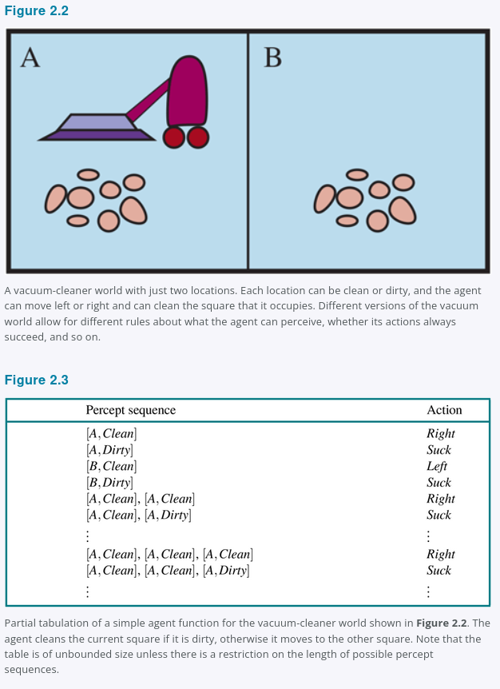
COMP 469 · Chapters 1 & 2 Expanded
Agent function ≠ agent program
The function is abstract; the program is the implementation.
Agent function
Mathematical mapping: percept sequence → action. Could be tabulated in principle.
Agent program
Compact code that implements behavior. Runs on sensors, actuators, and hardware.
COMP 469 · Chapters 1 & 2 Expanded
Notes:
Use Figure 2.2 and 2.3 from the chapter to show the difference. An agent function is a complete mapping from every possible percept history to an action. A program is how we implement that mapping compactly. This distinction matters because a lookup table is impossible for realistic agents. In Lab 01, the code students write is an agent program; the behavior it produces is part of the agent function. Source image: uploaded Chapter 2, Figures 2.2 and 2.3.

Slide 63
COMP 469 · Chapters 1 & 2 Expanded
Why a tiny vacuum world teaches real AI
Small environments reveal big design ideas.
• Percepts: location and dirt status
• Actions: Left, Right, Suck, NoOp
• Performance: clean floor over time
• Environment dimensions can be changed
• Agent architecture changes behavior
The world is simple so students can focus on the agent design choices.
COMP 469 · Chapters 1 & 2 Expanded
Notes:
Students sometimes underestimate toy worlds. Explain that a toy environment is useful because every piece of the agent loop is visible. We can change observability, stochastic dirt, action costs, or grid size and immediately see how the best design changes. Connect directly to Lab 01: the coding is a vehicle for understanding reflex, model-based, and goal-based behavior.

Slide 64
COMP 469 · Chapters 1 & 2 Expanded
Rationality checklist
A rational choice is relative to four pieces of information.
1
Performance measure
2
Percept sequence so far
3
Prior knowledge
4
Available actions
Do not ask 'Was it perfect?' Ask 'Was it expected to perform best given what it knew?'
COMP 469 · Chapters 1 & 2 Expanded
Notes:
This slide turns the formal definition into a classroom checklist. For any proposed action, ask: What score are we maximizing? What has the agent perceived? What does it know before acting? What actions can it legally take? Use this to evaluate student examples and to avoid hindsight bias when judging an agent.

Slide 65
COMP 469 · Chapters 1 & 2 Expanded
Rationality is not omniscience
Rational agents cannot be blamed for information they could not have.
Omniscient
Rational
Knows the actual outcome of each action before acting. Impossible in reality.
Chooses the action with the best expected performance using current percepts and knowledge.
Example
Looking before crossing a road is rational because it improves expected performance; being hit by an unforeseeable falling object does not make the original decision irrational.
COMP 469 · Chapters 1 & 2 Expanded
Notes:
Use the Chapter 2 street-crossing example. The point is to distinguish expected performance from actual hindsight. Rationality is not magic; it depends on percepts and feasible information gathering. Ask students: is it rational to look both ways? Yes, because information gathering can improve expected performance.

Slide 66
COMP 469 · Chapters 1 & 2 Expanded
Autonomy: less dependence on designer assumptions
A rational agent should learn from its own percepts when possible.
Fixed reflexes
Model updates
Learning from experience
More autonomy
• Built-in knowledge helps at the start
• Percepts should improve future behavior
• Learning reduces fragility when assumptions fail
COMP 469 · Chapters 1 & 2 Expanded
Notes:
Explain autonomy as a spectrum. A completely hand-coded agent may work only when designer assumptions are correct. Learning allows the agent to adapt. The sphex wasp and dung beetle examples from Chapter 2 show what happens when fixed behavior fails. In Lab 01, a model-based agent becomes more autonomous than a simple reflex agent because it uses past percepts.

Slide 67
COMP 469 · Chapters 1 & 2 Expanded
PEAS example: Vacuum World
Use PEAS before designing the program.
Performance
Environment
Clean squares over time; penalties for moves or energy
Grid rooms; dirt; walls or obstacles; possibly stochastic dirt
Actuators
Sensors
Left, Right, Up, Down, Suck, NoOp
Current location; current square status; maybe bump
Changing PEAS changes the rational agent.
COMP 469 · Chapters 1 & 2 Expanded
Notes:
Use this slide to prepare for the lab. Students should be able to fill PEAS before writing code. Ask: What if the sensor cannot see location? What if suction sometimes fails? What if dirt appears randomly? Each change alters environment classification and may require a different agent architecture.

Slide 68
COMP 469 · Chapters 1 & 2 Expanded
Class activity: build a PEAS table
Students can apply PEAS to any AI system.
spam filter
medical diagnosis assistant
recommender system
warehouse robot
Performance
Environment
Actuators
Sensors
Prompt: choose one system and fill the four PEAS rows in two minutes.
COMP 469 · Chapters 1 & 2 Expanded
Notes:
Suggested activity: assign each row of the room a different system, or let students choose one. After two minutes, ask for one PEAS row at a time. Instructor answers: Spam filter sensors include email contents and metadata; actuators include labeling, quarantine, deletion; environment includes inbox and adversarial senders; performance includes blocking spam without blocking legitimate mail. Medical assistant: sensors include patient data; actions include recommendations; performance includes accuracy, safety, calibration, fairness, and clinician usability.

Slide 69
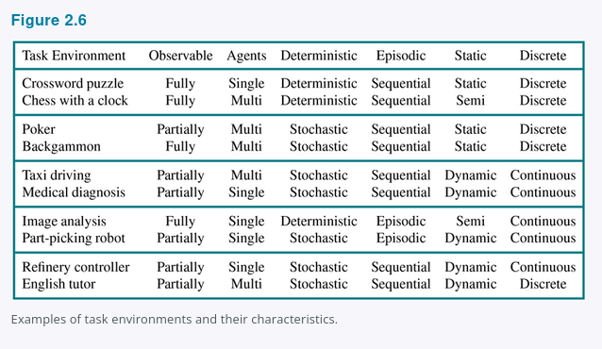
COMP 469 · Chapters 1 & 2 Expanded
Environment dimensions predict agent difficulty
The harder side of each dimension usually requires richer agent design.
Fully observable
→
Partially observable
harder
Single-agent
→
Multiagent
harder
Deterministic
→
Stochastic
harder
Episodic
→
Sequential
harder
Static
→
Dynamic
harder
Discrete
→
Continuous
harder
Known
→
Unknown
harder
Ask: what changes in the agent when the world becomes partially observable?
COMP 469 · Chapters 1 & 2 Expanded
Notes:
This slide summarizes Section 2.3. The right side of each pair usually forces more sophisticated agents: memory, probability, planning, game theory, online learning, or control. Source image/table: uploaded Chapter 2, Figure 2.6. Ask students to classify chess, poker, taxi driving, and the vacuum world. Use the answers to preview later chapters.

Slide 70
COMP 469 · Chapters 1 & 2 Expanded
Classify environments by examples
Students learn the dimensions by comparing tasks.
Crossword
Chess
fully observable, deterministic, static, discrete
fully observable, deterministic, multiagent, sequential
Poker
Taxi
partially observable, stochastic, multiagent
partially observable, stochastic, dynamic, continuous
Image classifier
Vacuum lab
episodic, static, often fully observable
can be changed to test each property
COMP 469 · Chapters 1 & 2 Expanded
Notes:
Use this slide as a quick quiz. Ask students to classify each example before revealing or discussing the text. Important nuance: classification depends on how the task is formulated. For example, a vacuum world with only local dirt sensors is partially observable; a simulator that gives the full grid is fully observable. This nuance is important for the lab.

Slide 71
COMP 469 · Chapters 1 & 2 Expanded
Environment properties change the algorithm
The same goal can require very different methods.
Fully observable + deterministic
Partially observable
Search and planning can use explicit states and transitions.
Agent needs memory, belief states, filtering, or information gathering.
Stochastic
Multiagent
Agent needs probabilities and expected utility.
Agent must consider cooperation, competition, communication, and games.
This is why Chapter 2 comes before the algorithm chapters.
COMP 469 · Chapters 1 & 2 Expanded
Notes:
This slide gives students a reason to care about classification. Environment properties are not vocabulary for vocabulary's sake. They guide algorithm choice. If the world is deterministic and known, search may work. If it is stochastic, use probability. If it is multiagent, use game theory. If it is partially observable, maintain beliefs or gather information.

Slide 72
COMP 469 · Chapters 1 & 2 Expanded
Class activity: match the architecture
Which agent type fits each problem best?
Thermostat
→
Answer in notes
Robot vacuum mapping a house
→
Answer in notes
Route planner
→
Answer in notes
Self-driving car choosing risk tradeoffs
→
Answer in notes
Game-playing agent improving from experience
→
Answer in notes
Have students answer before revealing the instructor notes.
COMP 469 · Chapters 1 & 2 Expanded
Notes:
Suggested answers: Thermostat = simple reflex because current temperature drives a rule. Robot vacuum mapping a house = model-based because it tracks visited places and obstacles. Route planner = goal-based because it searches for a path to a destination. Self-driving car = utility-based because it trades off safety, legality, comfort, time, and uncertainty. Game-playing agent improving from experience = learning agent. Point out that real systems often combine architectures.

Slide 73
COMP 469 · Chapters 1 & 2 Expanded
Bridge to Lab 01: Vacuum World Agents
The lab turns Chapter 2 vocabulary into runnable code.
Reflex agent
Model-based agent
Goal-based agent
Current percept → action. No memory. Good for seeing limits of reactive rules.
Stores visited squares and known status. Builds a partial internal map.
Uses BFS to plan a path to a dirty square. Replans as the world changes.
Lab learning goal: make each agent run, then explain its behavior using AIMA vocabulary.
COMP 469 · Chapters 1 & 2 Expanded
Notes:
This slide aligns the lecture with the provided Lab 01 teacher notes. Emphasize that the code is a vehicle for conceptual understanding. A correct reflex agent should not store visited cells. A model-based agent should maintain an internal model. A goal-based agent should use a search procedure such as BFS. Reference: uploaded COMP469_Lab01_Teacher_Notes.md.

Slide 74
COMP 469 · Chapters 1 & 2 Expanded
Common Lab 01 mistakes to watch for
These mistakes are conceptual, not just coding errors.
Reflex agent has memory
Performance = dirt collected
Then it is not reflex anymore.
Can reward the wrong behavior.
Model = full ground truth
Goal agent never replans
A model should be built from percepts.
World changes can make a plan stale.
Use the vocabulary to debug the design before debugging the code.
COMP 469 · Chapters 1 & 2 Expanded
Notes:
Instructor guidance from the Lab 01 notes: students often put a visited set in the reflex agent, which makes it model-based. They may confuse the agent's internal model with the simulator's ground truth. They may optimize dirt collected rather than clean floor over time. They may cache a BFS path even when the world changes. Use these mistakes as formative feedback opportunities.

Slide 75
COMP 469 · Chapters 1 & 2 Expanded
Chapters 1 & 2 concept map
The course foundation in one picture.
AI
Rational agent
Task environment
PEAS
Architecture
Representation
Big idea: intelligence is analyzed as choosing actions that achieve objectives in environments.
COMP 469 · Chapters 1 & 2 Expanded
Notes:
Use this near the end to consolidate. AI is not a grab bag of techniques; the textbook's organizing idea is rational agents. To design one, specify PEAS, classify the environment, choose an architecture, and choose a representation. Later algorithms are tools for implementing pieces of this concept map.

Slide 76
COMP 469 · Chapters 1 & 2 Expanded
Quick review quiz
Use as an exit ticket or exam review.
1. What are the four approaches to AI?
2. Why is a lookup-table agent infeasible?
3. What does PEAS stand for?
4. Give one example of partial observability.
5. When do goals become insufficient and utilities become useful?
Answers are in the speaker notes.
COMP 469 · Chapters 1 & 2 Expanded
Notes:
Answers: 1. Acting humanly, thinking humanly, thinking rationally, acting rationally. 2. The number of possible percept sequences is enormous or infinite, so a complete table does not scale. 3. Performance measure, Environment, Actuators, Sensors. 4. A taxi cannot see what other drivers are thinking; a vacuum with only a local dirt sensor cannot know whether distant squares are dirty; poker players cannot see opponents' cards. 5. Utilities are useful when there are tradeoffs, conflicting goals, preferences among outcomes, or uncertainty about success.

Slide 77
COMP 469 · Chapters 1 & 2 Expanded
How to read any AI system
A practical checklist for students.
• What environment is the system operating in?
• What percepts does it receive?
• What actions can it take?
• What performance measure is being optimized?
• What representation does it use?
• What could go wrong if the objective is misspecified?
This checklist turns news about AI into technical analysis.
COMP 469 · Chapters 1 & 2 Expanded
Notes:
This slide helps students apply Chapters 1 and 2 outside class. When they see a headline about AI, they can ask these questions instead of reacting vaguely. The same checklist works for chatbots, medical tools, recommender systems, robots, and autonomous vehicles. It also provides a framework for student presentations or short written reflections.

Slide 78
COMP 469 · Chapters 1 & 2 Expanded
Core references and URLs
Use these links for students who want to read further.
AIMA official site
https://aima.cs.berkeley.edu/
Turing 1950, Computing Machinery and Intelligence
https://doi.org/10.1093/mind/LIX.236.433
Dartmouth AI origin story
https://home.dartmouth.edu/about/artificial-intelligence-ai-coined-dartmouth
IBM Deep Blue history
https://www.ibm.com/history/deep-blue
AlphaGo Nature paper
https://www.nature.com/articles/nature16961
NIST AI Risk Management Framework
https://www.nist.gov/itl/ai-risk-management-framework
COMP 469 · Chapters 1 & 2 Expanded
Notes:
These are the visible URL references for the lecture deck. AIMA is the primary textbook reference. Turing is the original imitation-game paper. Dartmouth gives the historical origin of the term artificial intelligence. IBM and DeepMind provide historical examples. NIST provides a practical risk-management framework. Use these in the syllabus or LMS if desired.

Slide 79
COMP 469 · Chapters 1 & 2 Expanded
Additional sources and image credits
Instructor-facing references for the expanded slides.
OECD AI Principles
https://www.oecd.org/en/topics/ai-principles.html
DeepMind AlphaGo overview
https://deepmind.google/research/alphago/
Computer History Museum: Shakey
https://www.computerhistory.org/revolution/artificial-intelligence-robotics/13/289
IEEE Milestone: Shakey
https://ethw.org/Milestones%3ASHAKEY%3A_The_World%E2%80%99s_First_Mobile_Intelligent_Robot%2C_1972
Shakey image used
https://robogeek.ru/files/blogs/0004/2301/_cache/fit650x800-shakey.jpg
Chapter images
Uploaded Chapter_1.docx and Chapter_2.docx course materials
COMP 469 · Chapters 1 & 2 Expanded
Notes:
This slide provides additional source URLs and image credits. Images extracted from Chapter_1.docx and Chapter_2.docx are treated as course materials provided by the instructor. The Shakey photo is embedded in the deck and credited here and in the speaker notes for the Shakey slide.

Slide 80
COMP 469 · Chapters 1 & 2 Expanded
Final questions
Connect this lecture to the rest of the course.
Next: problem-solving agents and search
BFS, DFS, UCS, A*, and heuristic reasoning begin from the agent framework you learned today.
COMP 469 · Chapters 1 & 2 Expanded
Notes:
Close by asking students to explain how Chapter 2 leads into Chapter 3. A problem-solving agent has a goal, a state representation, actions, and a search algorithm to choose a path. Remind them that every algorithm later in the course sits inside an agent that perceives and acts in an environment.

